Slide 1
Handling Numerical and Categorical Data with Python - ScikitLearn

Slide 2
Course outline
Analyze various ways to deal with numerical and categorical data in Python ( Module: scikit-learn)
Discuss the differences between numerical and categorical data
Use Python modules to rescale a feature in numerical data sets
Discuss outliers and various ways to detect them
Use Python modules to discretize a feature
Use Python modules to cluster observations
Use Python modules to address missing values
Use Python modules to encode nominal categorical values
Use Python modules to encode ordinal categorical values

Slide 3

Contents
Types of Textual Data
Feature Scaling
Data Discretization
Automatic Outliers detection
Imputing Missing Values
Encoding Categorical Values

Slide 4
Types of Textual Data
While collecting data or working with data, it is important to know the format of data to analyze or interpret insights from it.
There are mainly two kinds of textual data which we want to investigate while considering any textual data handling or machine learning.
Numerical Data
Categorical Data
It is important to identify both based on their differences and similarities.

Slide 5
Numerical Data
Numerical Data, as the name suggests it contains numbers and not in any language or descriptive format.
It is often referred to as quantitative data.
Numerical data is collected in number form and stands different from any form of number data types due to its ability to be statistically and arithmetically calculated.
There are two sub types of numerical data:
Continuous data
Discrete Data

Slide 6
Numerical Data
Discrete Data is nothing but representation of countable items, amounts frequencies etc
Discrete data basically takes countable numbers like 1, 2, 3, 4, 5, and so on. In the case of infinity, these numbers will keep going on.
Continuous data, as the name speaks it has data in the form of intervals or ranges
Continuous numerical data represent measurements, and their intervals fall on a number line. Hence, it doesn’t involve taking counts of the items.
It can be further divided into interval data and ratio data

Slide 7
Categorical Data
As the name suggests, it refers to data type that is based on a category or grouping
Categorical data refers to a data type that can be stored and identified based on the names or labels given to them.
The data collected in the categorical form is also known as qualitative data.
Each dataset can be grouped and labelled depending on their matching qualities, under only one category. This makes the categories mutual exclusive.
Height of a person is categorical data, as a person can only be tall, short etc

Slide 8
Categorical Data
There are two subtypes of Categorical Data namely
Nominal Data:
This is also called as named data
Nominal data is defined as data that is used for naming or labelling variables, without any quantitative value. Nominal data is non-parametric and doesn’t have a proper order
Note that the nominal data examples are nouns, with no order to them
Race is a nominal variable having a number of categories, but there is no specific way to order from highest to lowest

Slide 9
Categorical Data
Ordinal Data:
Includes data or elements of data that is ranked, ordered or used on a rating scale.
You can count and order ordinal data, but it doesn’t allow you to measure it.
The variables in ordinal data are listed in an ordered manner.
The ordinal variables are usually numbered, to indicate the order of the list.
However, the numbers are not mathematically measured or determined but are merely assigned as labels for opinions.

Slide 10
Feature Scaling
Numerical data generally has numbers in different ranges.
The dataset containing height in cms and weight in kilograms might mislead the model as the height values average around 175 whereas weight around 50 making model biased towards the height feature
To avoid these, we scale the data into a common range for all the features. For example, all the heights will be scaled such that they fall in the range 0-1 and same goes with weight.
There are two most common techniques of scaling numerical data namely Min-Max Normalization and Standardization

Slide 11
Data Normalization
Here all the values are scaled such that they are in the range [0,1] by default.
A value can be normalized by Min Max Normalization using the formula
Y = ( X – Min ) / ( Max – Min )
We can normalize the dataset using scikit-learn object MinMaxScaler
The default scale for the MinMaxScaler is to rescale variables into the range [0,1], although a preferred scale can be specified via the “feature_range” argument and specify a tuple, including the min and the max for all variables.

Slide 12
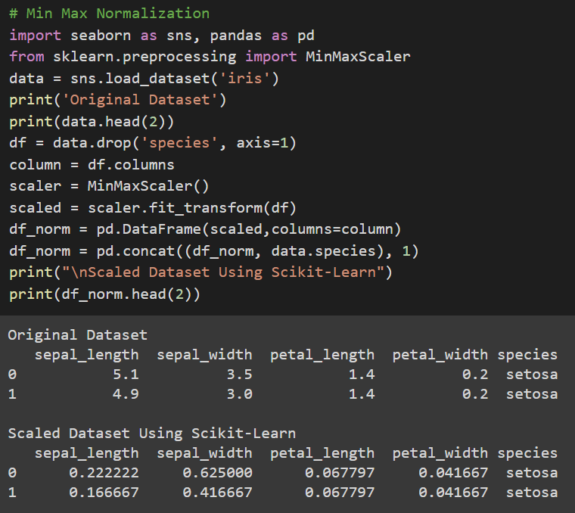
MinMaxScaler
Inbuilt Iris data is loaded
We will drop the species column because it has categorical data.
Sklearn module’s MinMaxScaler object is used to create an instance of min max scaler and the data is scaled using fit_transform method of the instance.
Data is normalized between [0,1]

Slide 13
Data Standardization
Standardization doesn’t have any fixed minimum or maximum value.
It can be computed using the formula
Y = ( X – Mean ) / ( Standard Deviation )
Here, the values of all the columns are scaled in such a way that they all have a mean equal to 0 and standard deviation equal to 1.This scaling technique works well with outliers. Thus, this technique is preferred if outliers are present in the dataset.
Standardization assumes that your observations fit a Gaussian distribution (bell curve) with a well-behaved mean and standard deviation

Slide 14
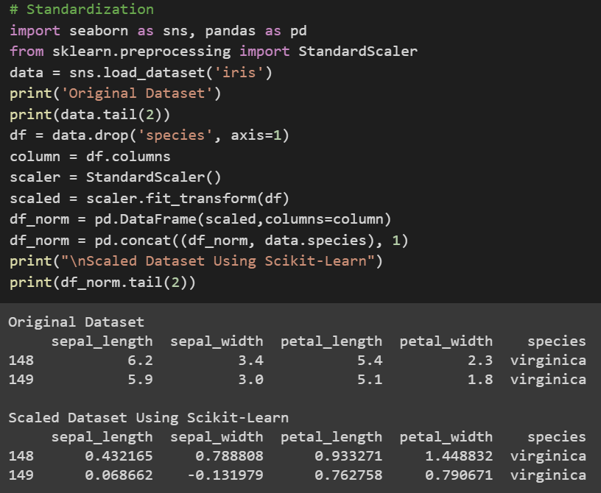
StandardScaler
Sklearn module’s StandardScaler object is used to create an instance of Standard scaler and the data is scaled using fit_transform method of the instance.
We can see that the mean value in each column is assigned a value of 0.0 if present and the values are centered around 0.0 with values both positive and negative.

Slide 15
Data Discretization
Data discretization is the process of converting continuous data into discrete buckets by grouping it. Discretization is also known for easy maintainability of the data.
Some famous methods of data discretization are binning and using a histogram.
Although data discretization is useful, we need to effectively pick the range of each bucket.
The main challenge in discretization is to choose the number of intervals or bins and how to decide on their width.

Slide 16
Data Discretization
Data discretization is process of converting continues numerical data into discrete bins.
There are 3 types of data discretization methods
Quantile Transformation
each bin has an equal number of values based on the percentiles
Uniform Transformation
each bin has equal or the same width with the possible values in the attribute
Kmeans Transformation
In this transformation, clusters are defined and values are assigned to them

Slide 17
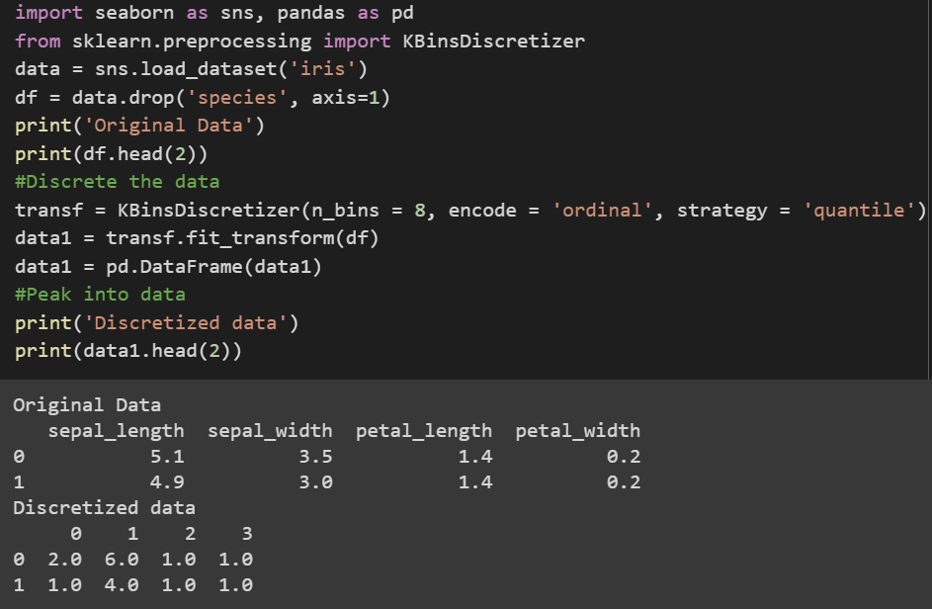
Data Discretization – Quantile Transformation
We are using iris dataset. The class we will be using is KBinsDiscretizer from sklearn.
The quantile transformation will bin the data records of each variable into 8 groups. Here, the number of records or values in each group will be the same or equal.

Slide 18
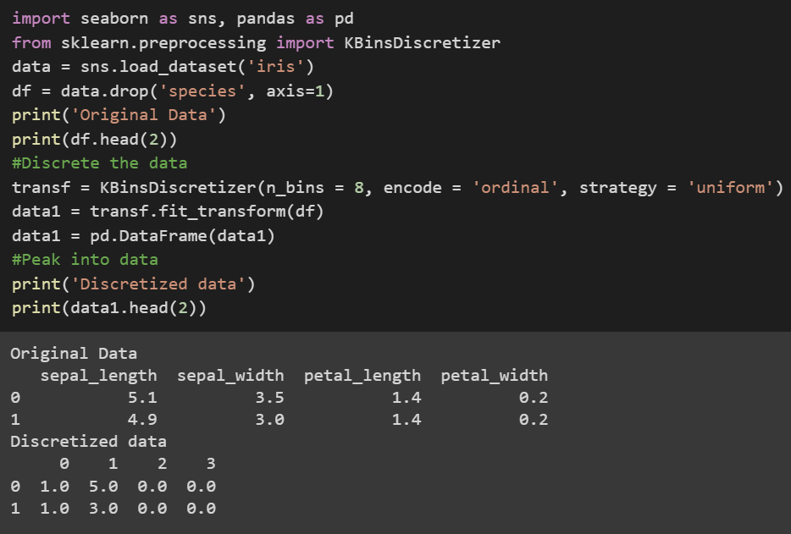
Data Discretization – Uniform Transformation
We are using iris dataset. The class we will be using is KBinsDiscretizer from sklearn.
In the Uniform transformation, each bin will be of equal width included with possible values in the variables
Rather than having equal values in each bin, the uniform transform have equal bin width with possible values

Slide 19
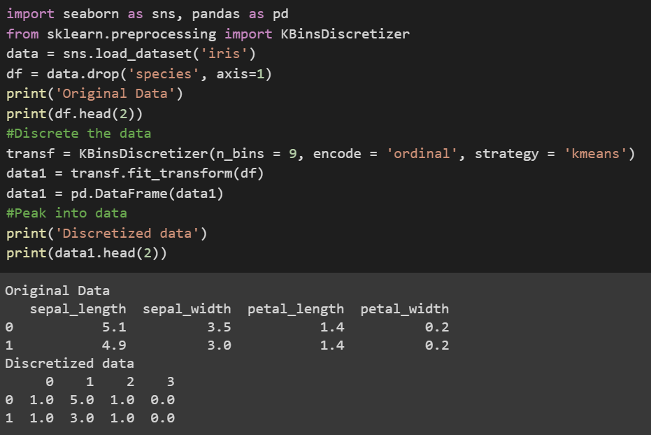
Data Discretization – Kmeans Transformation
We are using iris dataset. The class we will be using is KBinsDiscretizer from sklearn.
The KMeans will work quite differently than previous transformations. Here, Kmeans will try to fit the values into specified clusters.

Slide 20
Outliers
In a dataset there are some data items/ objects/ numbers which deviate from the so-called normal items/objects/numbers. These are called outliers
For example, if we are looking into heights data in feet normal heights range in between 4 to 7. Suppose we had a value which is 20, this is an outlier
They can be caused by measurement or execution errors.
The analysis for outlier detection is referred to as outlier mining. There are many ways to detect the outliers, and the removal process is same as removing a data item from the panda’s data frame.

Slide 21
Automatic Outliers Detection
The scikit-learn library provides several built-in automatic methods for identifying outliers in data. Some of them are:
Isolation Forest
Minimum Covariance Determinant
Local Outlier Factor
One Class SVM
Each method will be defined, then fit on the training dataset. The fit model will then predict which examples in the training dataset are outliers and which are not (so-called inliers)

Slide 22
Isolation Forest
Isolation Forest, or iForest for short, is a tree-based anomaly detection algorithm.
It is based on modeling the normal data in such a way as to isolate anomalies that are both few in number and different in the feature space.
The scikit-learn library provides an implementation of Isolation Forest in the IsolationForest class.
the most important hyperparameter in the model is the “contamination” argument, which is used to help estimate the number of outliers in the dataset. This is a value between 0.0 and 0.5 and by default is set to 0.1

Slide 23
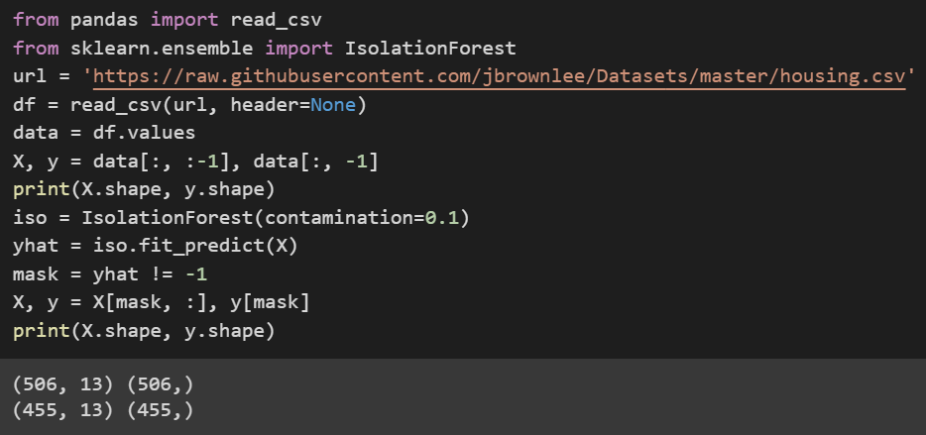
Isolation Forest
Loading the housing data set from the link provided. We then partition the data into X and Y where X are input features and Y is the target Variable. We can see that data has initially 506 rows and 13 columns with 1 target column.
Using the IsolationForest class from sklearn library we detect the outliers using fit_predict method. A mask is created and parsed over the dataset to remove the outlier records. Finally, we can see that there are 455 records

Slide 24
Minimum Covariance Determinant
If the input variables have a Gaussian distribution, then simple statistical methods can be used to detect outliers.
This approach can be generalized by defining a hypersphere (ellipsoid) that covers the normal data, and data that falls outside this shape is considered an outlier.
The scikit-learn library provides access to this method via the EllipticEnvelope class.
It provides the “contamination” argument that defines the expected ratio of outliers to be observed in practice. Let’s set it to 0.05 expecting 5% of outliers in the data.

Slide 25
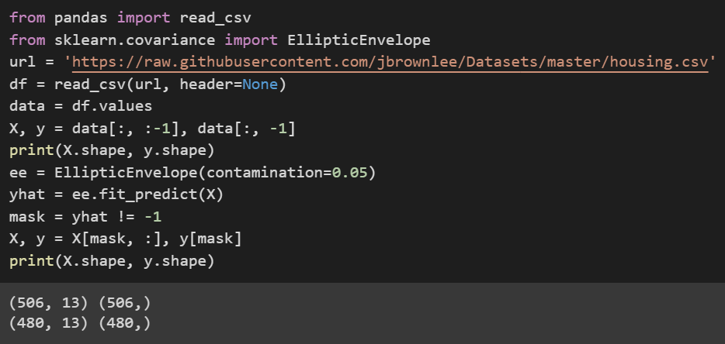
Minimum Covariance Determinant
Loading the housing data set from the link provided. We then partition the data into X and Y where X are input features and Y is the target Variable. We can see that data has initially 506 rows and 13 columns with 1 target column.
Using the EllipticEnvelope class from sklearn library we detect the outliers using fit_predict method and a contamination of 0.05. After removing the outliers, we can see that there are 480 records

Slide 26
Local Outlier Factor
Locate those examples that are far from the other examples in the feature space.
This can work well for feature spaces with low dimensionality (few features), although it can become less reliable as the number of features is increased, referred to as the curse of dimensionality.
The local outlier factor, or LOF for short, is a technique that attempts to harness the idea of nearest neighbors for outlier detection
The scikit-learn library provides an implementation of this approach in the LocalOutlierFactor class.

Slide 27
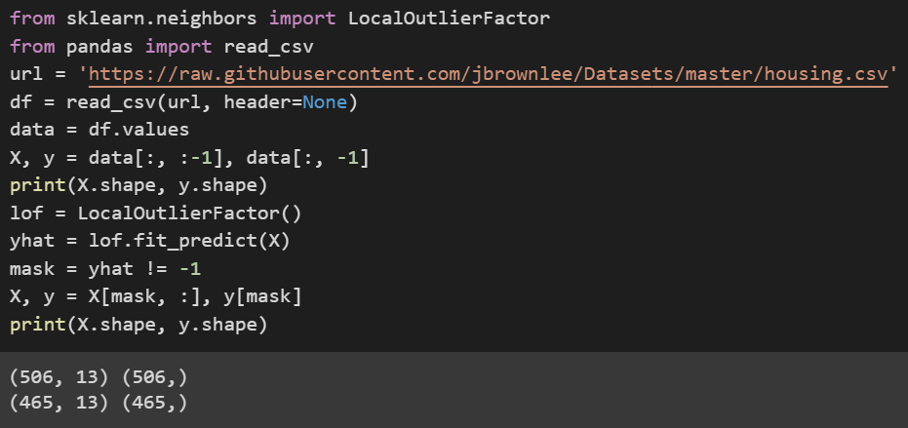
Local Outlier Factor
Loading the housing data set from the link provided. We then partition the data into X and Y where X are input features and Y is the target Variable. We can see that data has initially 506 rows and 13 columns with 1 target column. contamination argument indicated and defaults to 0.1.
Using the LocalOutlierFactor class from sklearn library neighbors module we detect the outliers using fit_predict method. After removing the outliers, we can see that there are 465 records

Slide 28
One-Class SVM
The support vector machine, or SVM, algorithm developed initially for binary classification can be used for one-class classification.
When modeling one class, the algorithm captures the density of the majority class and classifies examples on the extremes of the density function as outliers. This modification of SVM is referred to as One-Class SVM.
The scikit-learn library provides implementation of one-class SVM in the OneClassSVM class.
The class provides the “nu” argument that specifies the approximate ratio of outliers in the dataset and by default it is set to 0.1

Slide 29
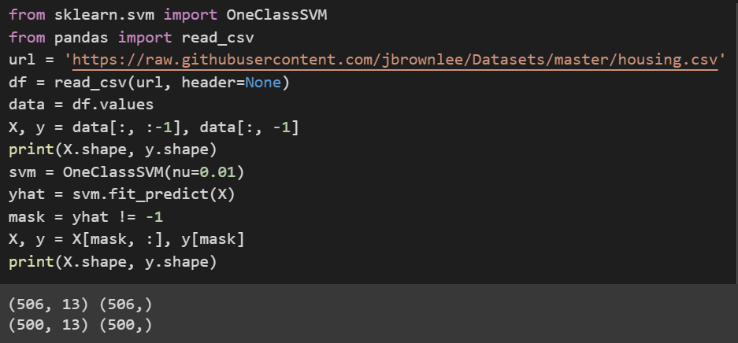
One-Class SVM
Loading the housing data set from the link provided. We then partition the data into X and Y where X are input features and Y is the target Variable. We can see that data has initially 506 rows and 13 columns with 1 target column. contamination argument indicated and defaults to 0.1.
Using the OneClassSVM class from sklearn library neighbors module we detect the outliers using fit_predict method and value of 0.01 for nu. After removing the outliers, we can see that there are 500 records

Slide 30
Handling Missing Values
Data Cleaning is the most time-consuming part of any data science project
Missing values are nothing but blank or null values present in the dataset.
However, there are many powerful tools to expedite this process. One of them is Pandas which is a widely used data analysis library for Python.
Missing values can be handled in two ways
Dropping the null values or missing value records
Replacing the null values

Slide 31
Imputing Missing Values
Imputing refers to using a model to replace missing values.
The scikit-learn library provides three mechanisms to deal with missing values:
Univariate Feature Imputation
Multivariate Feature Imputation
Nearest Neighbors Imputation
Any imputing performed on the training dataset will have to be performed on new data in the future when predictions are needed from the finalized model

Slide 32
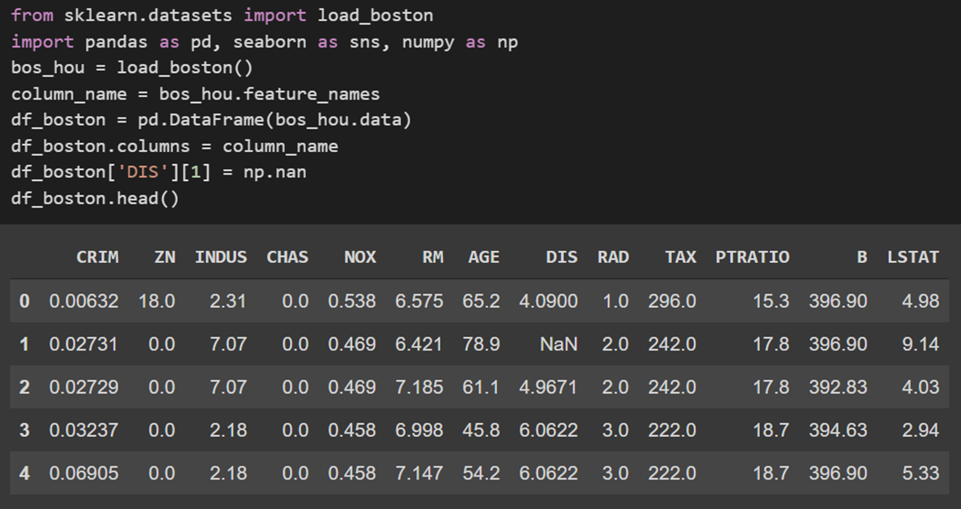
Imputing Missing Values
For performing various imputation methods to handle the missing values, let’s create a sample dataset. Let’s load the Boston houses dataset from sklearn library.
Let’s replace some of the values from DIS column in the dataset with NaN so that we can handle those values with various imputation methods

Slide 33
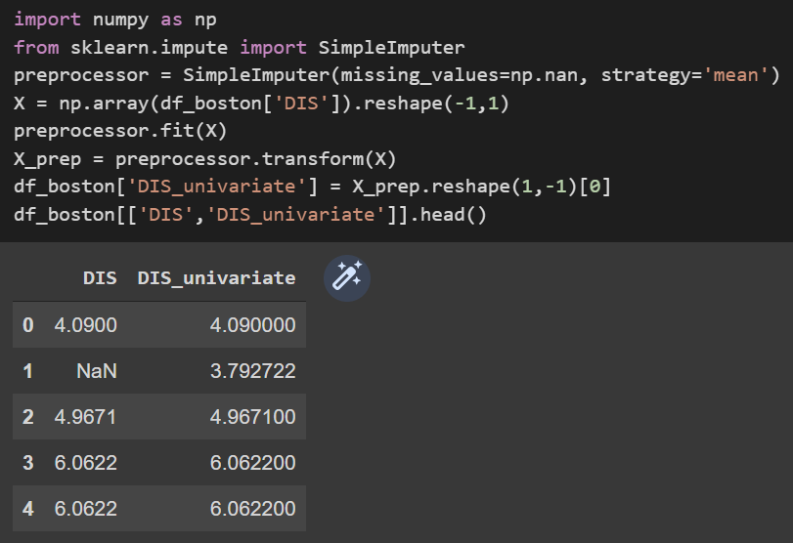
Univariate Feature Imputation
SimpleImputer Class is used to perform Univariate feature imputation.
We specify which is the missing value through the missing_values parameter and the replacement strategy through the strategy
We can see that NaN value is replaced with a value imputed by mean of the data.

Slide 34
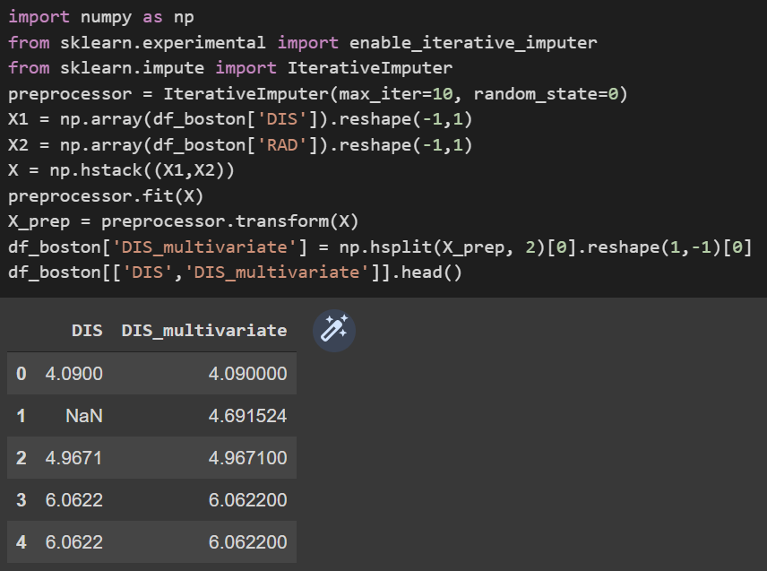
Multivariate Feature Imputation
In the multivariate feature imputation each feature with missing values is calculated as a function of the other features
Since the IterativeImputer is still at the experimental stage, we must enable it explicitly
We select number of iterations as 10 and random state as 0

Slide 35
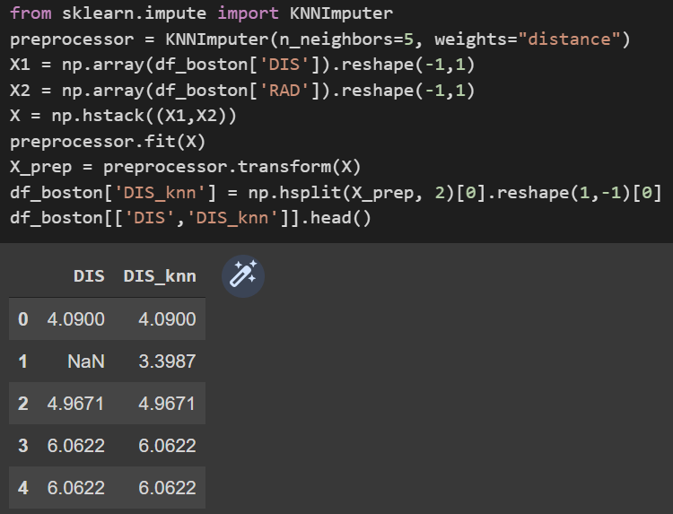
Nearest Neighbors Imputation
This category of imputation fills missing values using the KNN ( k-Nearest Neighbors ) approach. Each missing value is calculated using values from n_neighbors nearest neighbors that have a value.
We can use the KNNImputer class of the scikit-learn library

Slide 36
Encoding Categorical Values
Categorical valued columns have data in text categories which cannot be fed into the machine learning algorithms.
Sometimes in datasets, we encounter columns that contain categorical features (string values) for example parameter Gender will have categorical parameters like Male, Female. These labels have no specific order of preference and since the data is string labels, the machine learning model can not work on such data.
Hence we encode these columns into some split of columns with numerical data.
Common methods are one hot encoding and label encoding

Slide 37
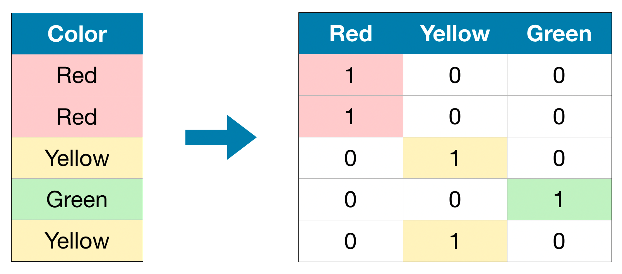
Encoding Nominal Categorical Values
One hot encoding can be applied on nominal categorical variables
One hot encoding allows us to turn nominal categorical data into features with numerical values while not mathematically imply any ordinal relationship between classes
Source : web

Slide 38
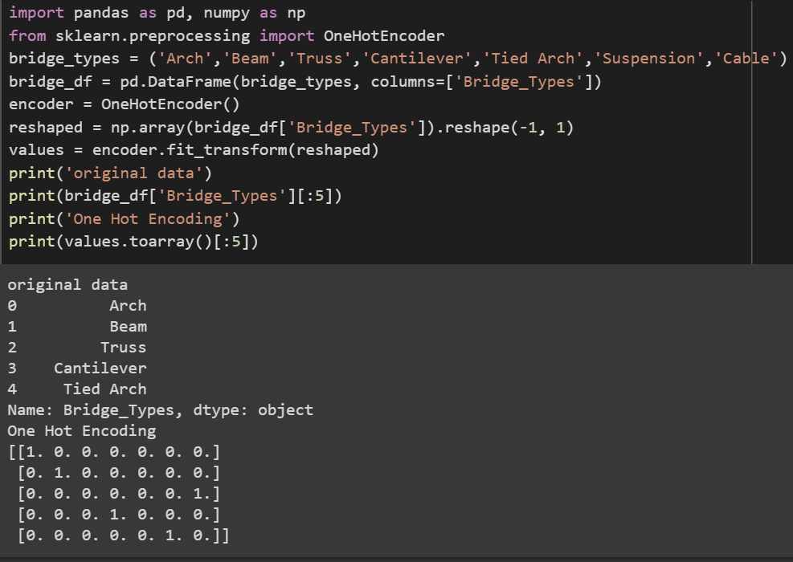
One Hot Encoding
A one hot encoding is a representation of categorical variables as binary vectors. This first requires that the categorical values be mapped to integer values.
Then, each integer value is represented as a binary vector that is all zero values except the index of the integer, which is marked with a 1.

Slide 39
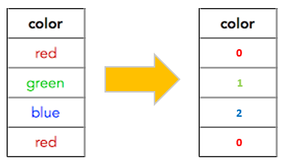
Encoding Ordinal Categorical Values
Label encoding is applied on ordinal categorical values
Label Encoding refers to converting the labels into a numeric form so as to convert them into the machine-readable form
Source : web

Slide 40
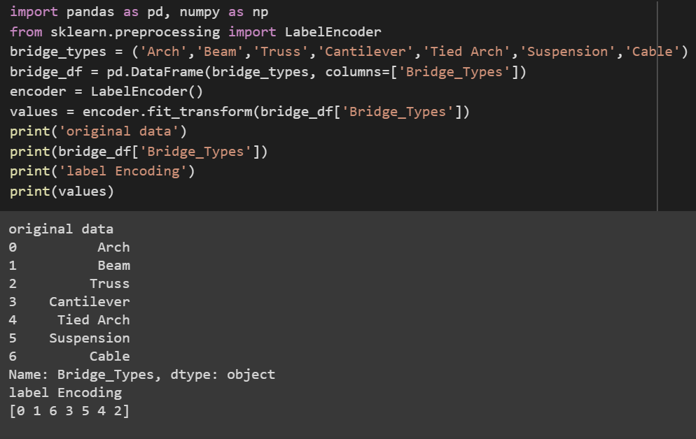
Label Encoding
Let’s create a sample data set assuming these are the different kinds of categories present in an ordinal variable in some dataset
Lets apply label encoding on the data to create a column which is the numerical representation of each label

Slide 41
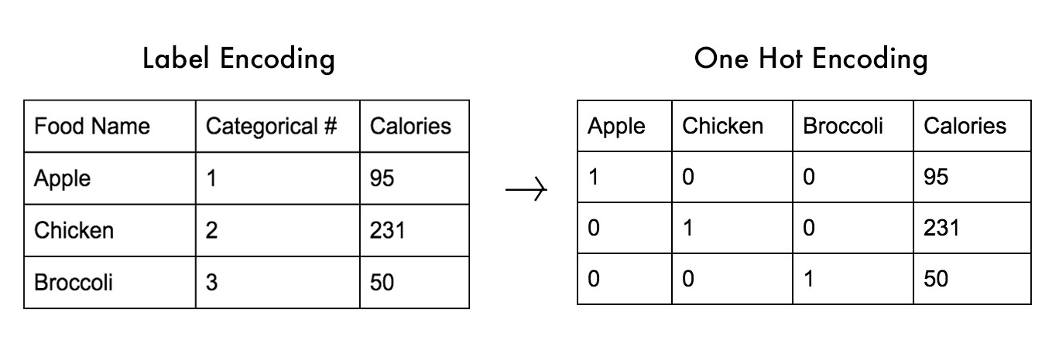
Label Encoding vs One Hot Encoding
In label encoding we will be replacing 1 with Appple and 2 with chicken etc. This will lead to a single numerically encoded column. Whereas in one-hot encoding, we end up with new columns. One-hot encoding takes a column with categorical values and then splits the column into multiple columns
Source : web

Slide 42
Assignment
In the attached sample.csv dataset encode the categorical features to numerical data and fill the missing values using the Interpolation of data in all the columns
Apply one hot encoding to the Industry column in the salary.csv file which is used in One hot encoding practice slides
Apply Label encoder for both country and industry column for salary.csv dataset
Discretize the data into different age bins using the salary dataset Age column

Slide 43
Summary

Slide 44
Q&A

